Slide 1
By Molly Faulkner, Wayland Historical Society, January 10, 2016 TALKING TRASH! GETTING RID OF WAYLAND’S REFUSE
A History of Burning, Burying, Recycling, Pig Farms, Composting,
Single Stream Recycling, 1-800-JUNK –

Slide 2
COURTESY CONCORD FREE PUBLIC LIBRARY

Slide 3
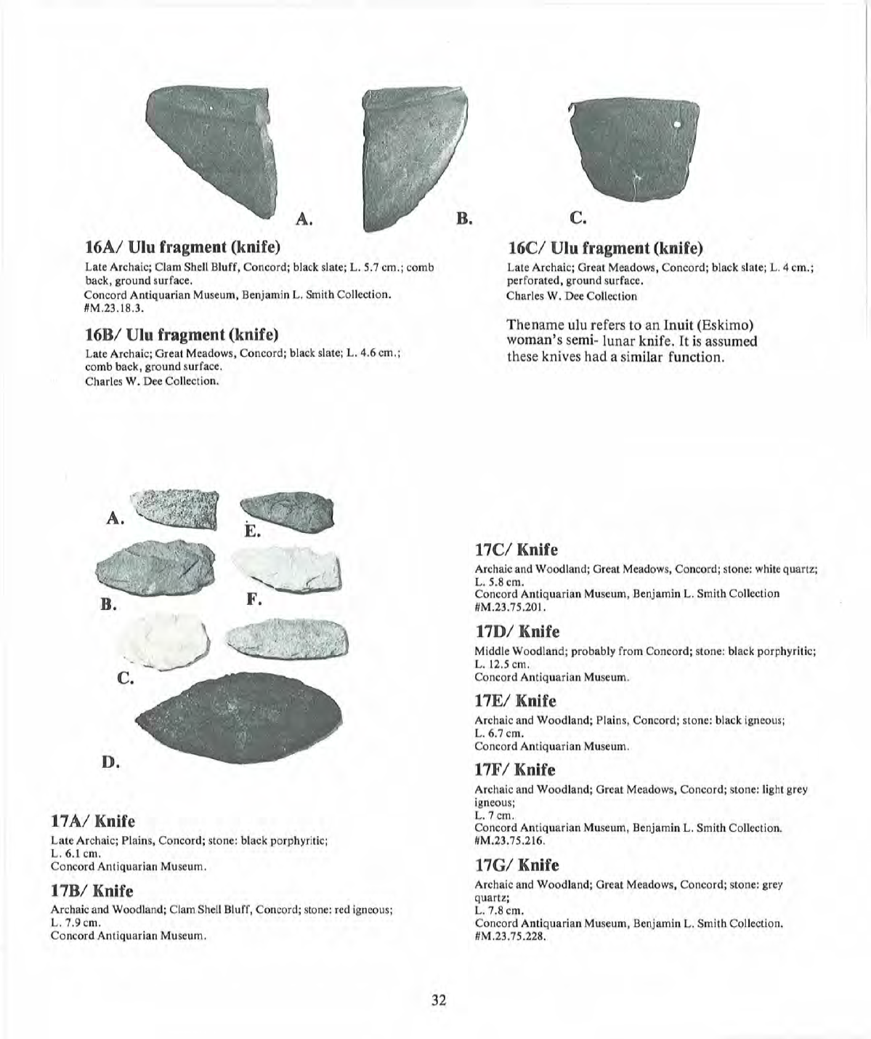

Slide 4
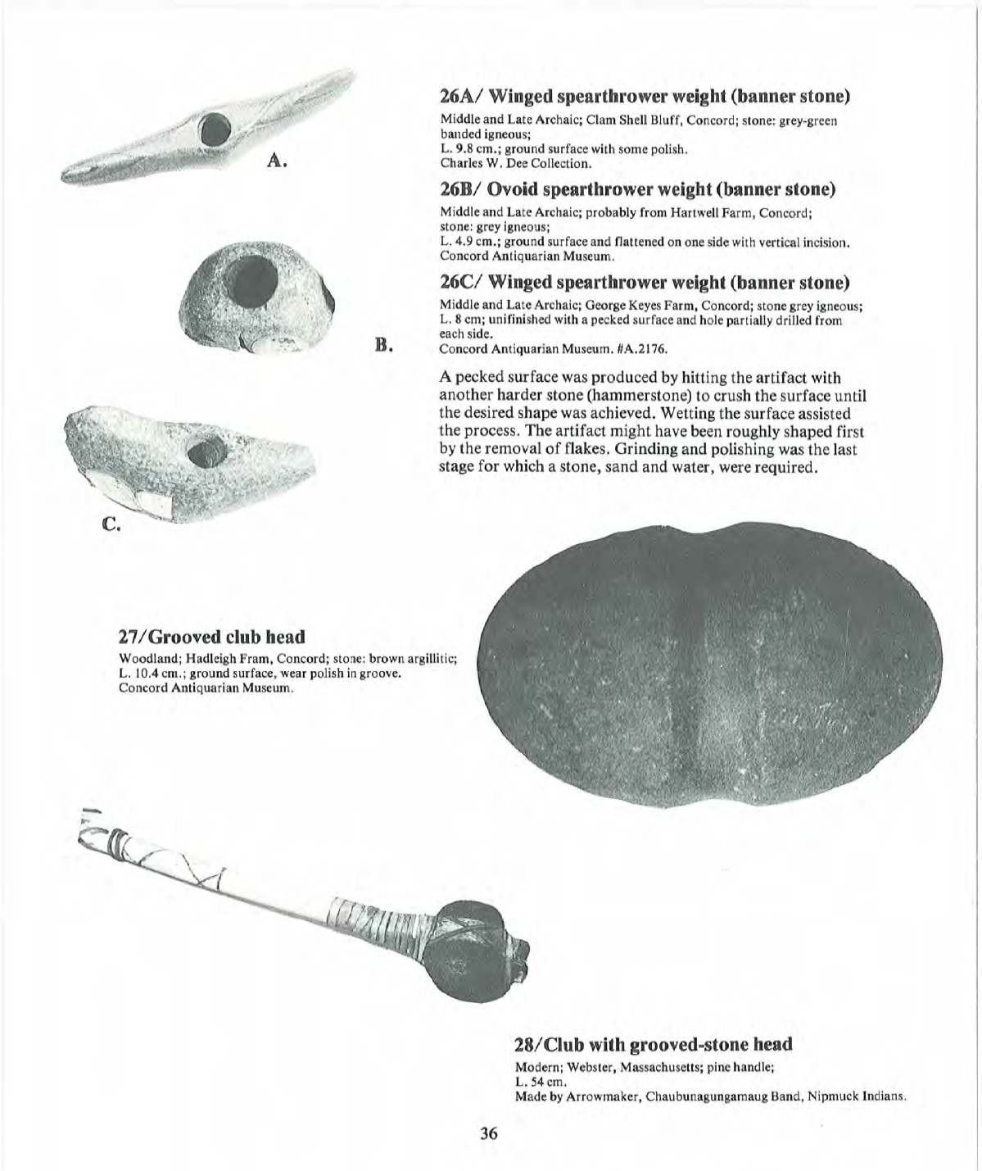

Slide 5
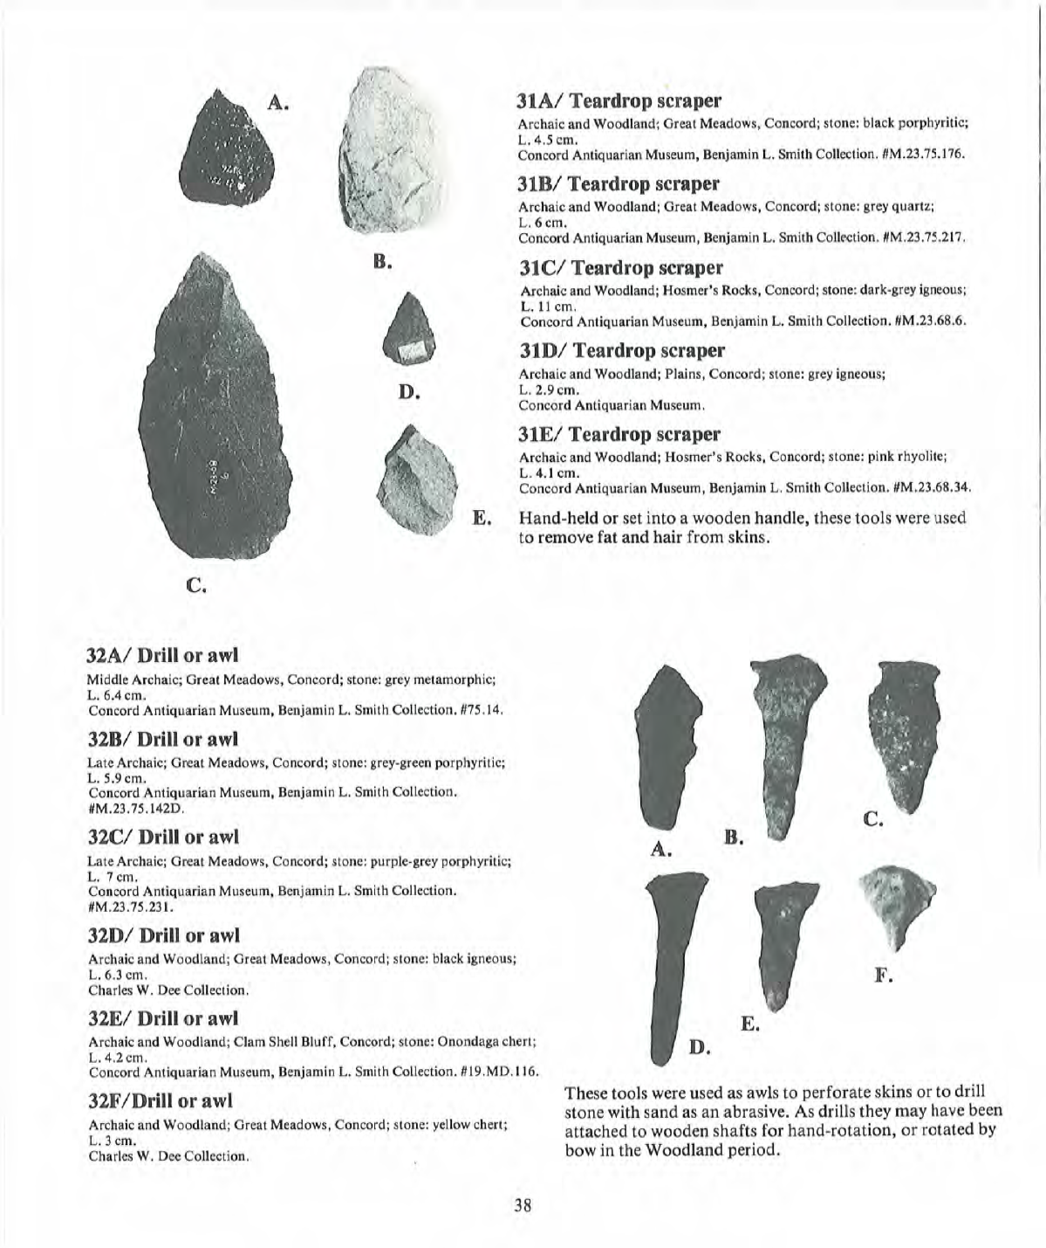

Slide 6
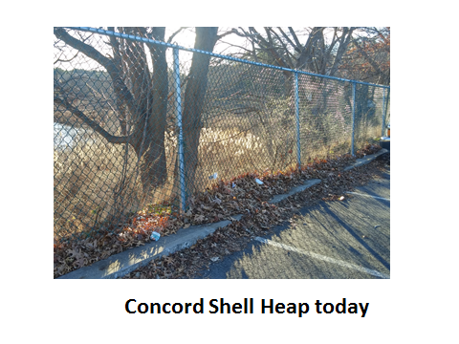

Slide 7
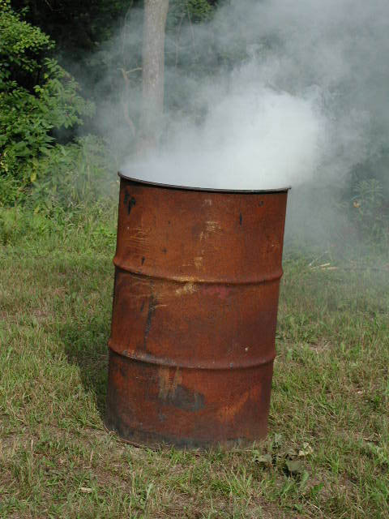

Slide 8
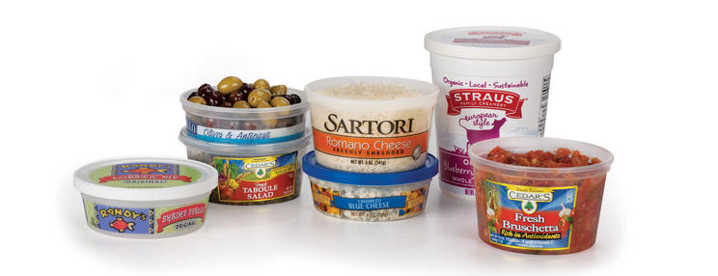
As we buy more pre-made guacamole, salsa, and already shredded parmesean cheese, we use more

Slide 9
30– consumers choose to buy more plastic packaging

Slide 10
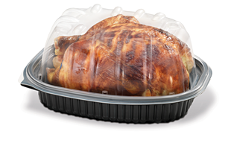
Who hasn’t bought one of these delectable birds?

Slide 11
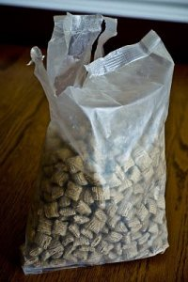
Even wax paper in cereal boxes has gone the way of the buggy whip

Slide 12
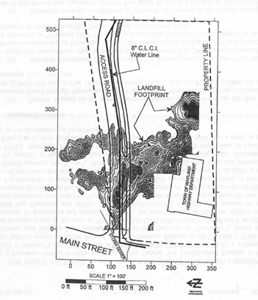

Slide 13
First Rt. 20 dump – is this Give and Take?

Slide 14
Route 20 First landfill looking toward Pelham Island

Slide 15
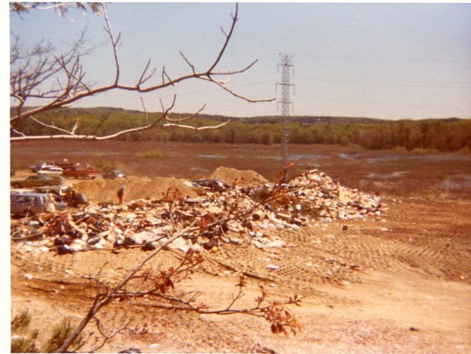
Guess where?

Slide 16
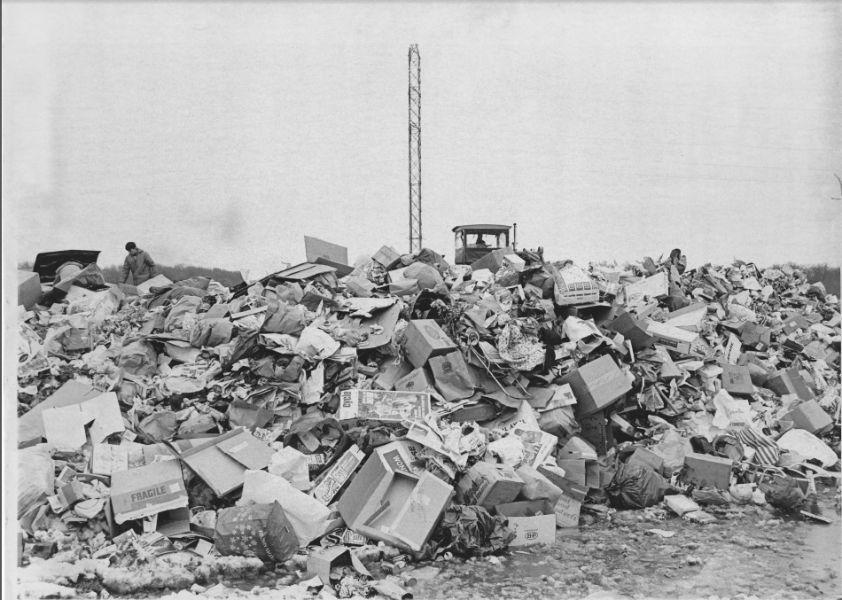
Wayland Route 20 dump 12.21.69

Slide 17
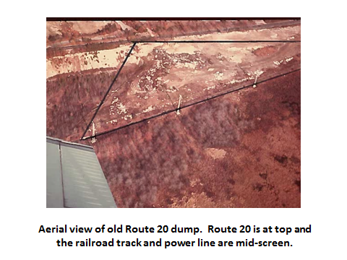

Slide 18
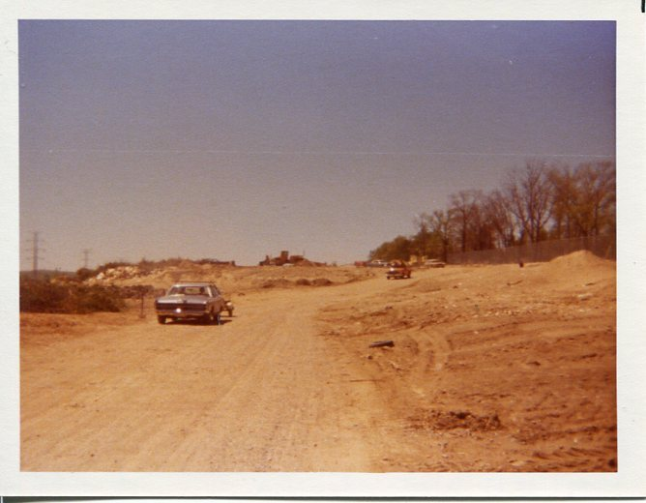
Rt. 20 to the right, marsh to left looking west. Cars in background are parked on 60 feet of trash 1977

Slide 19
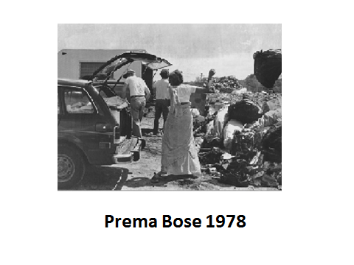

Slide 21
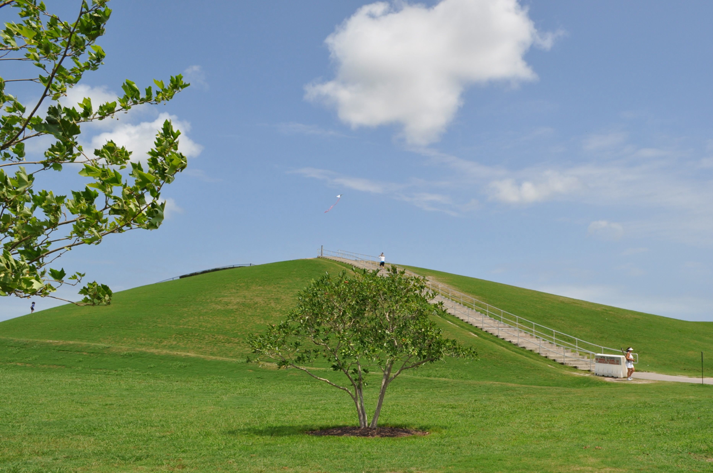
MT. TRASHMORE – VIRGIINIA BEACH

Slide 22
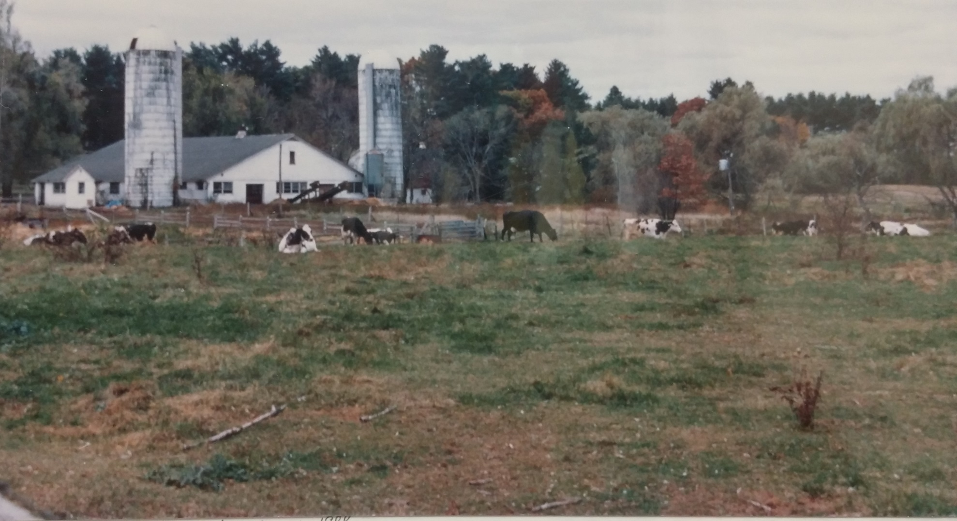
Watertown Dairy bought by Hyman Shick in 1938

Slide 23
BEAUTIFUL SEDGEMEADOW

Slide 24
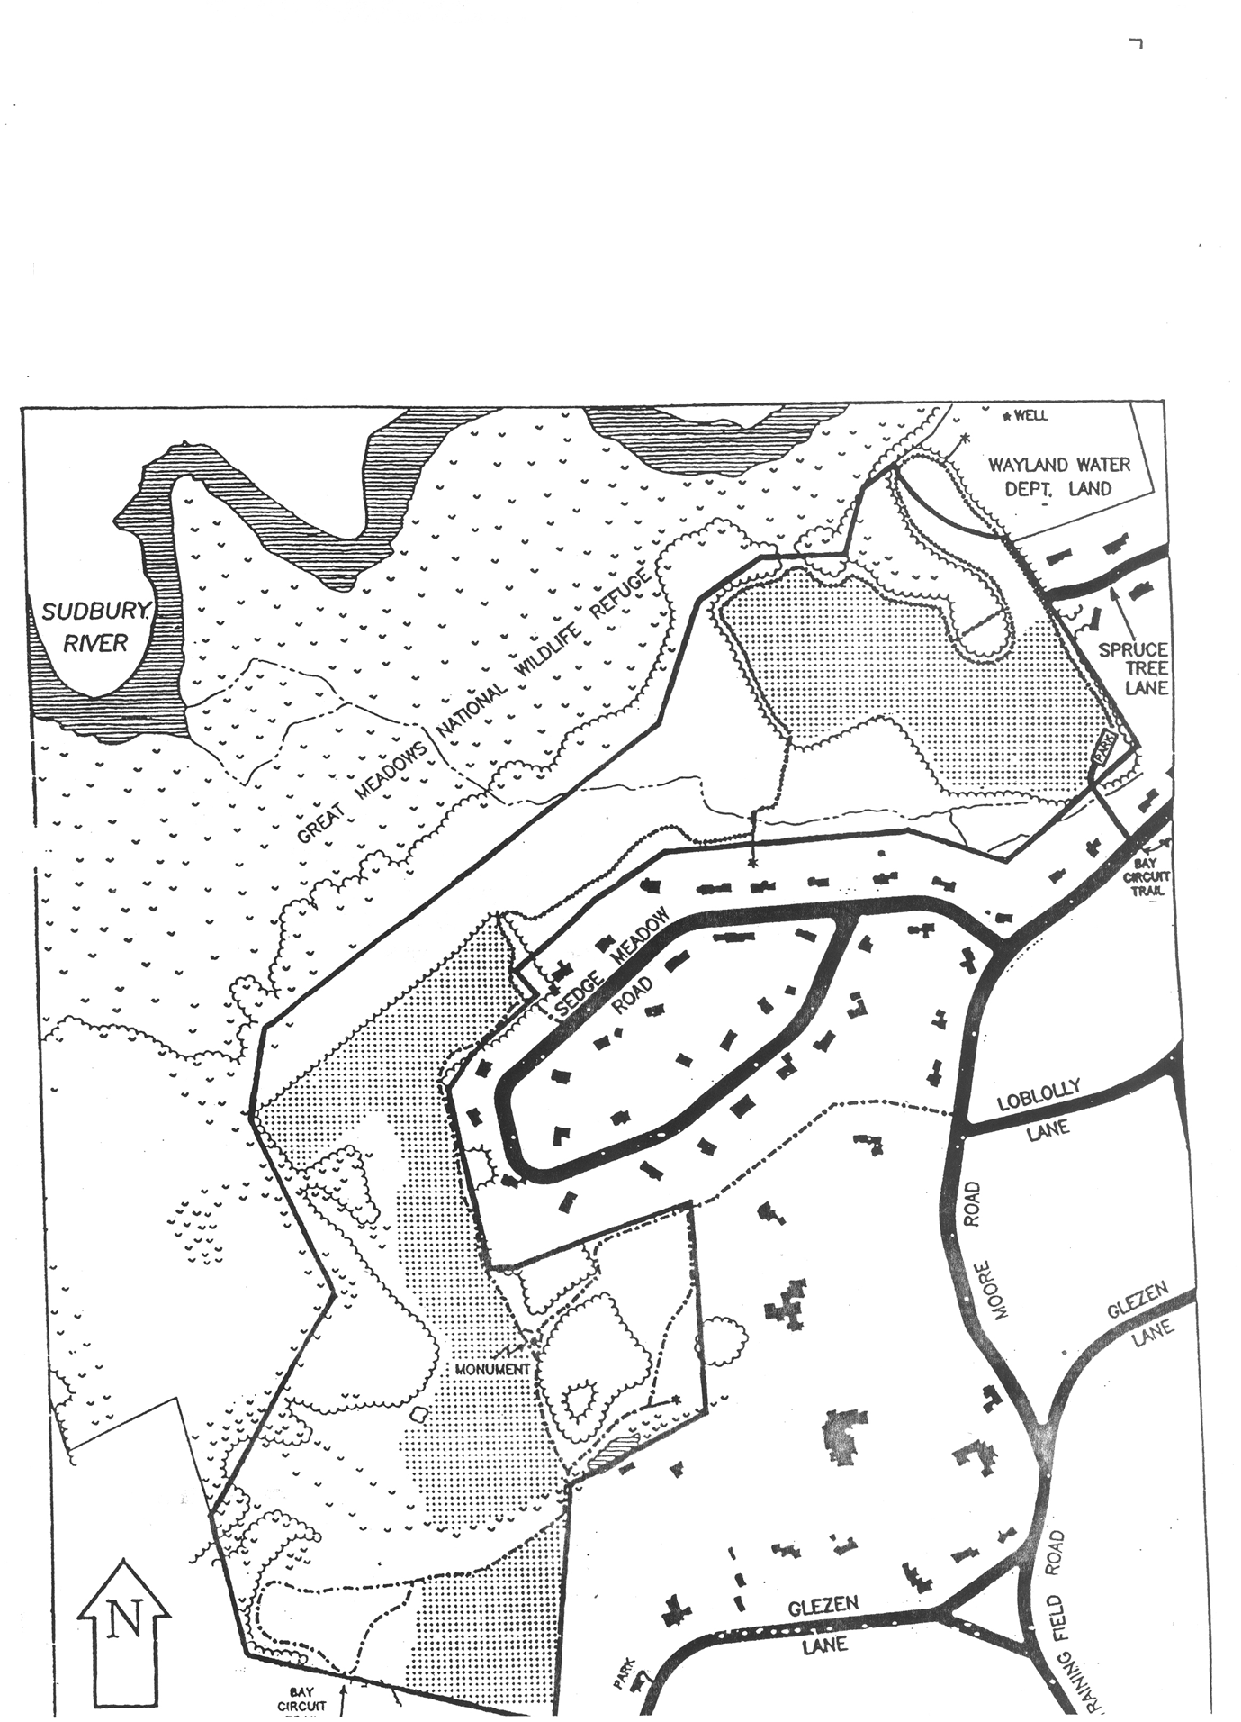

Slide 25
Wheelabrator in North Andover, MA

Slide 26
SHREWSBURY ASH LANDFILL

Slide 27
Clean up and investigation December 2015 at
Shrewsbury Ash Landfill

Slide 28
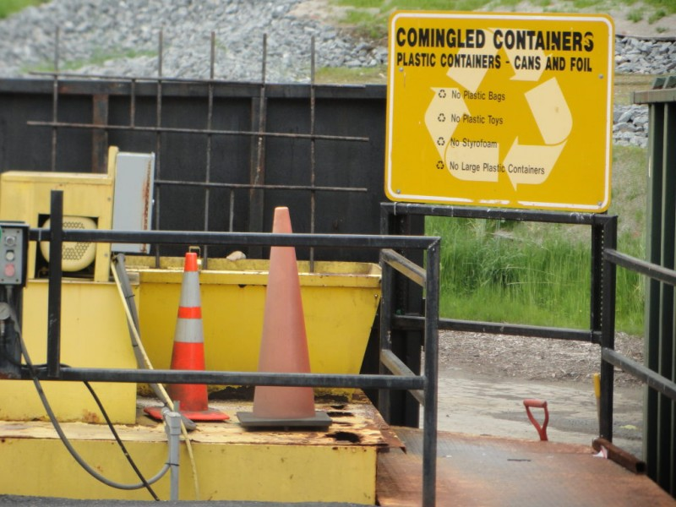
COMINGLING???

Slide 29
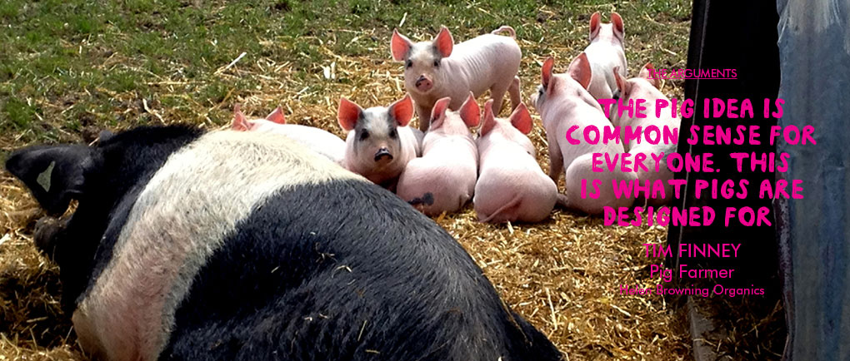
thepigidea.org

Slide 30
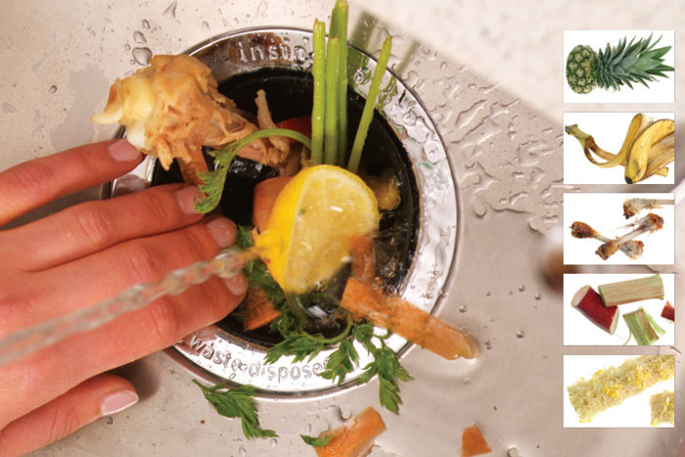

Slide 31
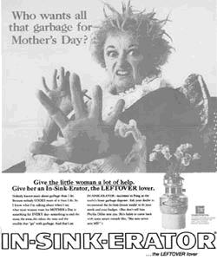

Slide 32
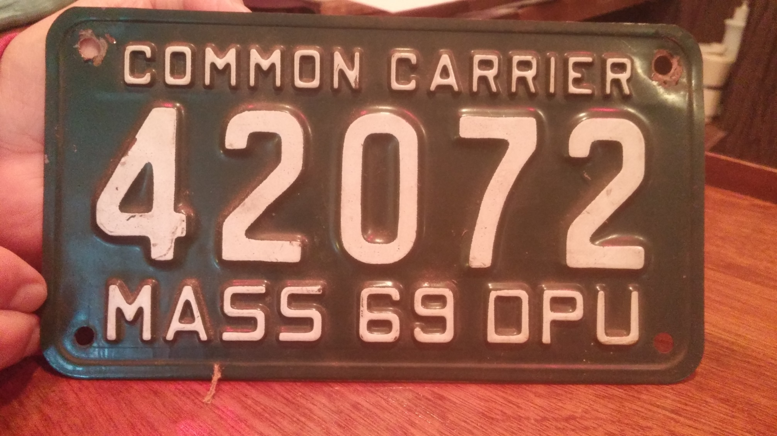

Slide 33
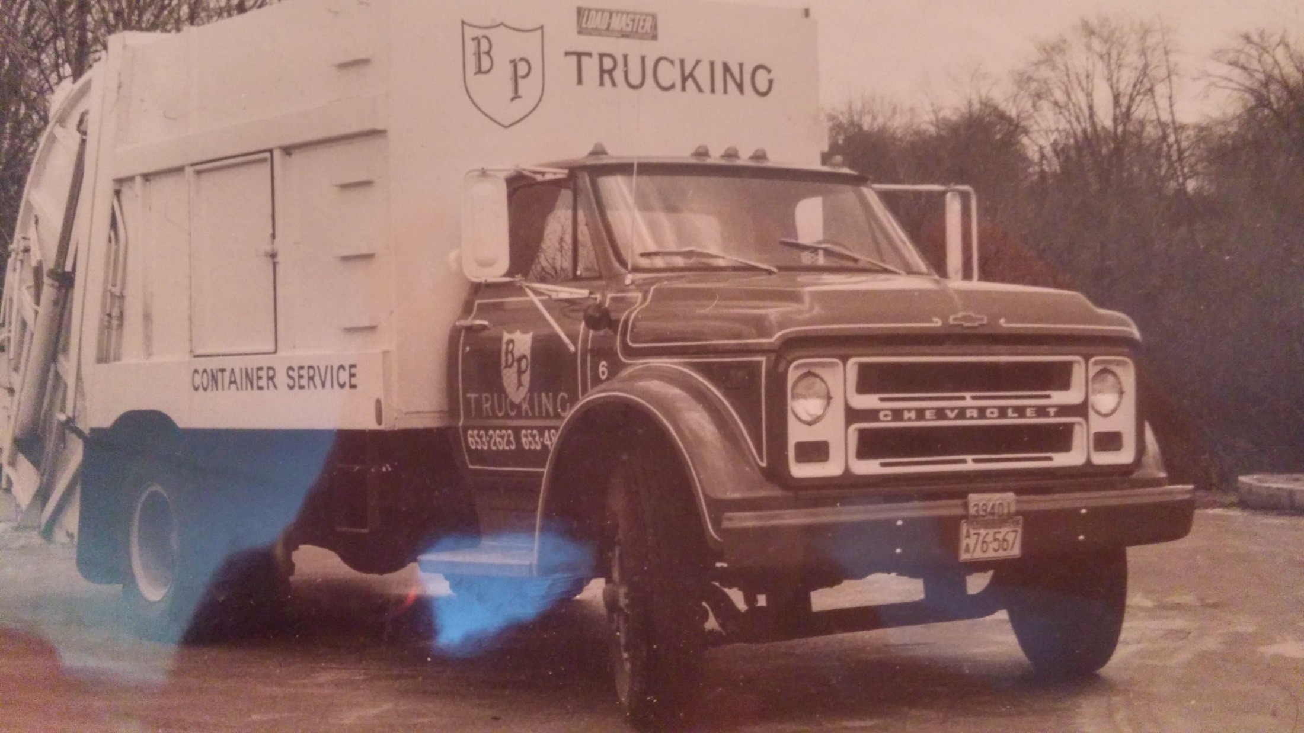

Slide 34
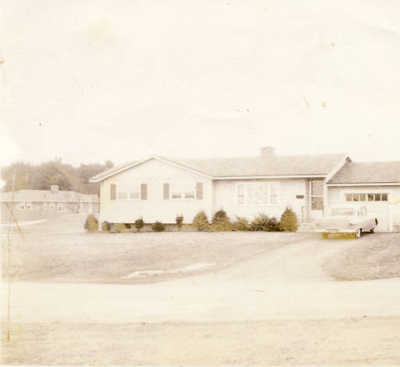
Damon Farm: “There weren’t many trees. It was like the Sahara Desert.” Pauline DiCesare

Slide 35
Clapypit Hill Composting Bins

Slide 36
COMPOSTING: Hidden Acres (Cassidy) Farm in Medway --- food scraps in trench

Slide 37
Hidden Acres (Cassidy) Farm in Medway – compost steaming in cold weather

Slide 38
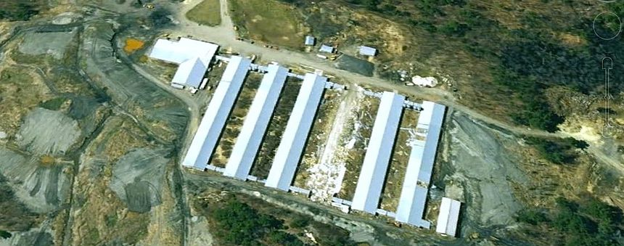
A soil
Mass Natural’s 25 acre family owned commercial composting operation on a 250 acre farm in Westminster
© 2023 by My Agrolinx. Proudly created with Wix.com

Slide 39
Converting ‘Waste’ to Renewable Energy
Food waste and organics…
… into anaerobic digestion

Slide 40
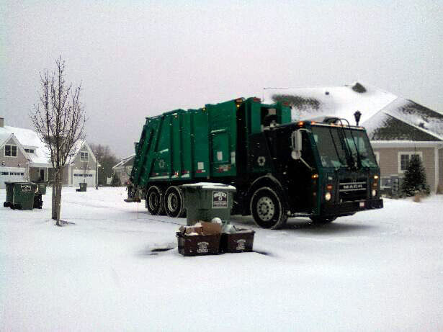
ORIFICE : $400 to $500 per year on Bennett Road
for trash and recycling pickup

Slide 41
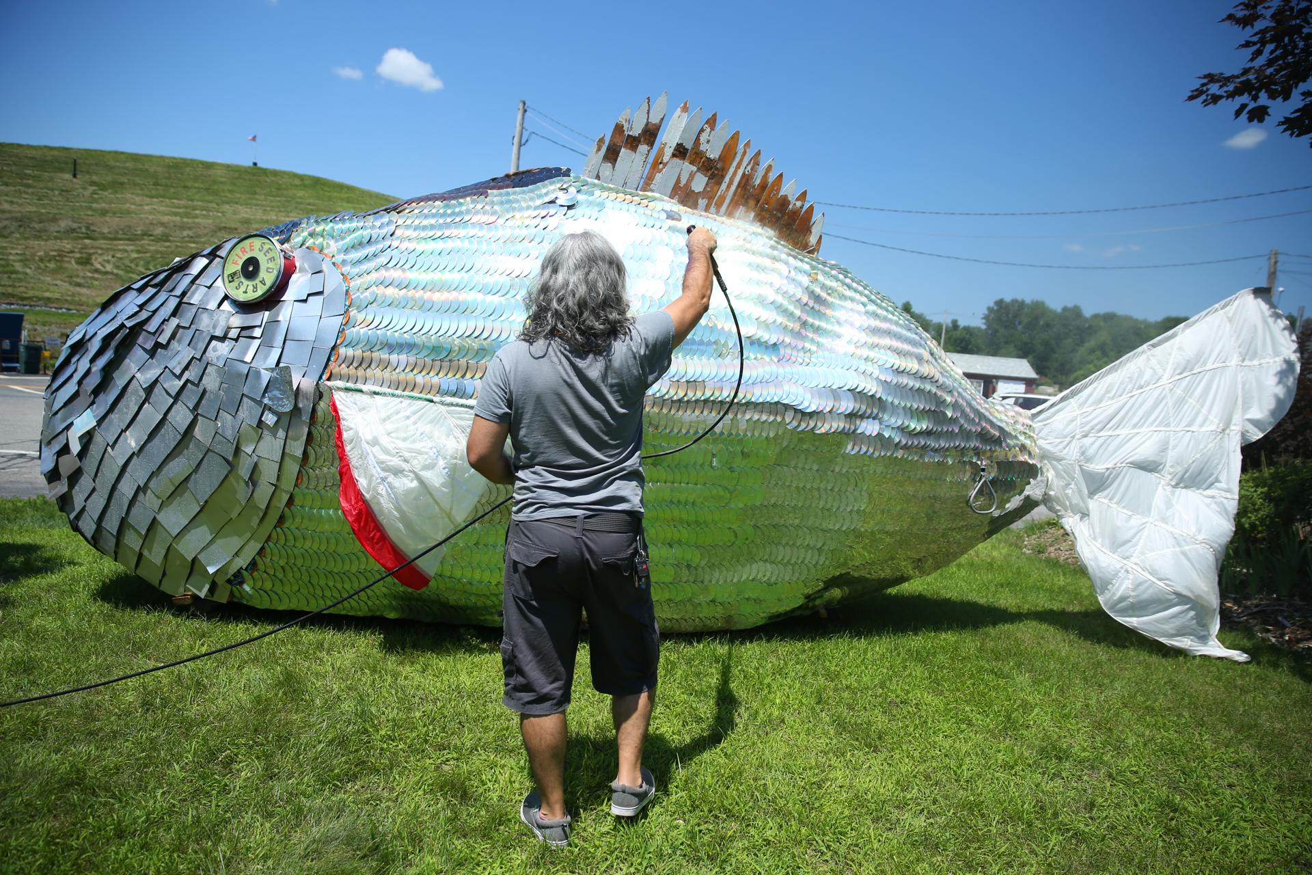
Remember MOBY DISC?

Slide 42
COVANTA SEMass in Rochester, MA

Slide 43
2007 Fire at COVANTA SEMass

Slide 44
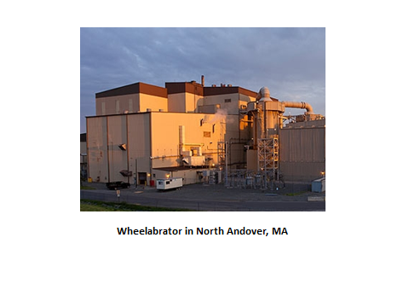

Slide 45
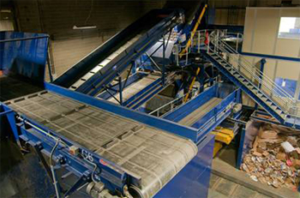

Slide 46
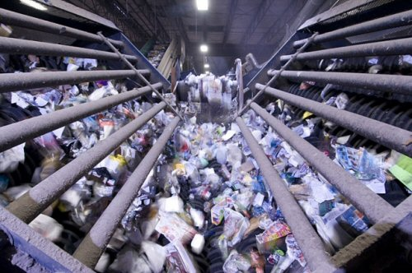

Slide 48
WAYLAND SCHOOLS GREEN TEAM TEXTILES RECYCLING

Slide 49
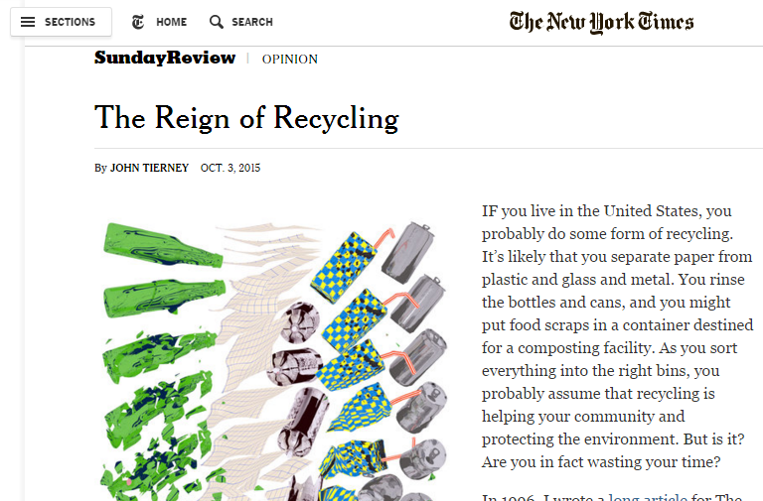
Critique of recycling practices in October 4, 2015 New York Times Sunday Review

Slide 50
5,278 groups with 9,155,733 members across the globe
entirely nonprofit movement of people who are giving (and getting) stuff for free in their own towns
keeps stuff out of landfills
almost 3000 members in Wayland - Kim Reichelt is a moderator

Slide 51
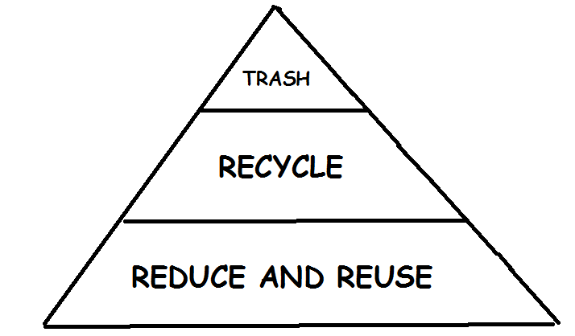

Slide 52
TRASH TALK
You are the reason they put instructions on shampoo.
Man, you're like school on Sunday. No class.
Hey, ref-- can I pet your seeing eye dog after the game?
I'd agree with you but then we'd both be wrong.
Shut up, you'll never be the man your mother is.
You'll have better luck trying to score with your sister
I had better luck scoring with your sister.

